Slide 1

LARAVEL
PHP ARTISAN
Notes:
le parsing json de la request et de la réponse (du coup ausi j'ai vu, c'est specifique aux POST/PUT)
req.body
accessoirement la gestion des erreur dans le catch

Slide 2


# OBJECTIVES FOR TODAY
Understand differences artisan command
Use artisan command to create:
- Model
- Controller
- Migration
Check route list
Migrate table

Slide 3



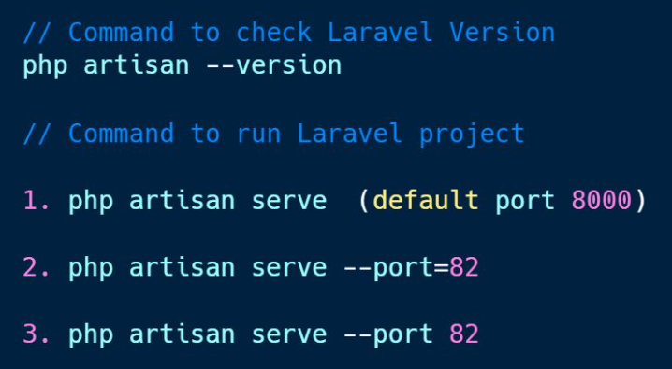
EXPLAIN
# Basic artisan command
05 MNI
Artisan is the name of the command-line interface included with Laravel. It provides a number of helpful commands for your use while developing your application.
What is artisan?
Why we use it?
Example

Slide 4


PRACTICE
Activity 1
5 MIN
INDIV
Use artisan command
Check Laravel Version
Run your Laravel project with port 8080

Slide 5
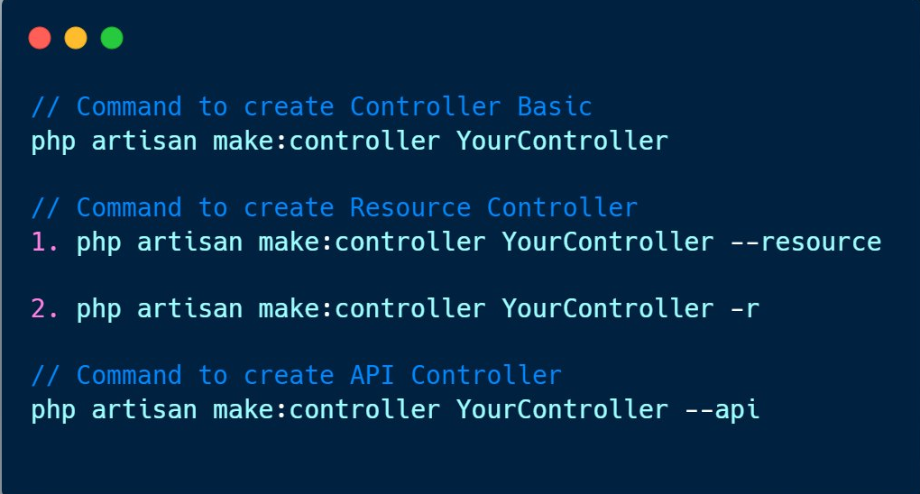
EXPLAIN
# Create controller
05 MNI
Example

Slide 6
PRACTICE
Activity 2
5 MIN
INDIV
Use artisan commands to create 3 controllers
Basic controller name: BasicController
Resource controller name: TaskController
API controller name: ProductController
After creating all controllers check on each controller what are the differences?

Slide 7
EXPLAIN
# Create model
05 MIN
php artisan make:model YourModel
Example
php artisan make:model Post

Slide 8
EXPLAIN
# Create migration
05 MIN
Migrations are like version control for your database, allowing your team to define and share the application's database schema definition.
keyword
php artisan make:migration create_table_name_table
keyword
Example
php artisan make:migration create_posts_table

Slide 9
PRACTICE
Activity 3
5 MIN
INDIV
Use artisan command to create 3 models & 3 tables
Model: Task and table: tasks
Model: Person and table: people
Model: Product and table: products

Slide 10
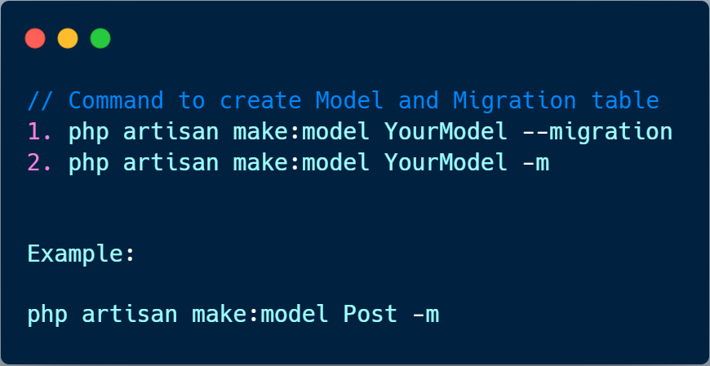
EXPLAIN
# Create model with migration
05 MIN
Now let delete all Model and Migration from activity 3 and re-create it again

Slide 11
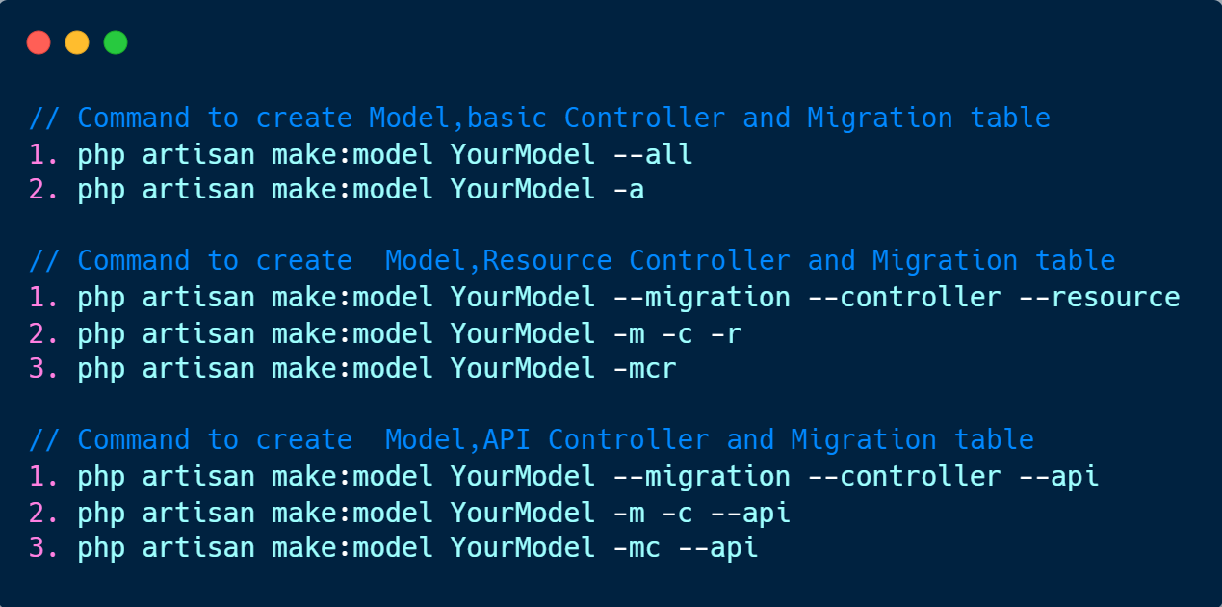
EXPLAIN
# Create model, Controller and migration
05 MIN

Slide 12

PRACTICE
Activity 4
5 MIN
INDIV
Delete all previous Model, Controller and Migration table that you created
Use artisan command to create 3 models, 3 controller & 3 tables
Model: Task , Controller: TaskController and table: tasks
Model: Person, Controller: PersonController and table: people
Model: Product, Controller: ProductController and table: products

Slide 13
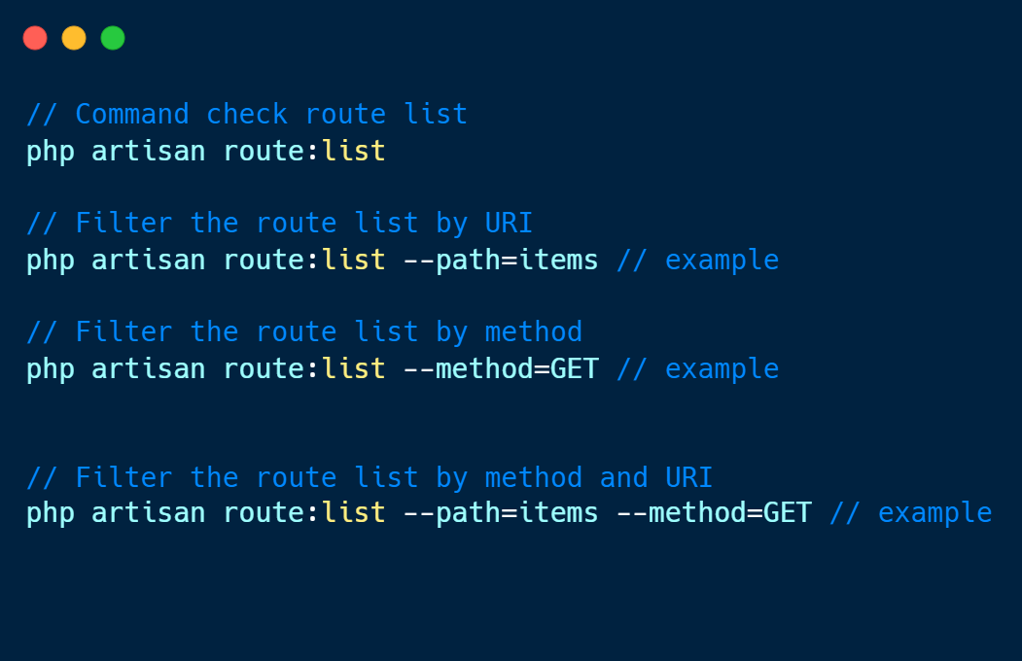
EXPLAIN
# Check route list
05 MIN

Slide 14
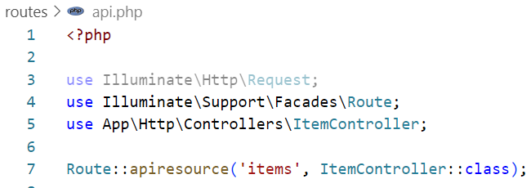
PRACTICE
Activity 5
10 MIN
INDIV
Create 3 API Controllers: ProductController, ItemController and TaskController
Use it in API route: api.php
Q1: Check all routes list using artisan command
Q2: Check only route list that has method GET
Q3: Check only route list that has path items and method DELETE

Slide 15
EXPLAIN
# Migrate table
05 MIN
A migration class contains two methods: up and down. The up method is used to add new tables, columns, or indexes to your database, while the down method should reverse the operations performed by the up method.
# Running Migrations
php artisan migrate

Slide 16
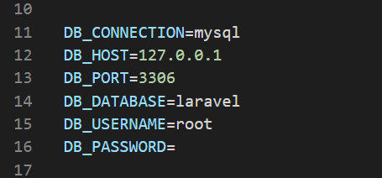
PRACTICE
Activity 5
5 MIN
INDIV
Delete all previous Migration table that you created
Start your Xammp SQL Server and go to PhpMyAdmin
Create new database name: product-db
Open .env file and configure your database
Follow the step
4. Open terminal and type: php artisan migrate
5. Check the result on PhpMyAdmin what do you see?

Slide 17
# OBJECTIVES FOR TODAY
Understand differences artisan command
Use artisan command to create:
- Model
- Controller
- Migration
Check route list
Migrate table

